Slide 1



06.E Managing Passwords
set a password management policy for users, and manually lock and unlock user accounts.

Slide 2

/etc/shadow

Slide 3
Encrypted password

Slide 4
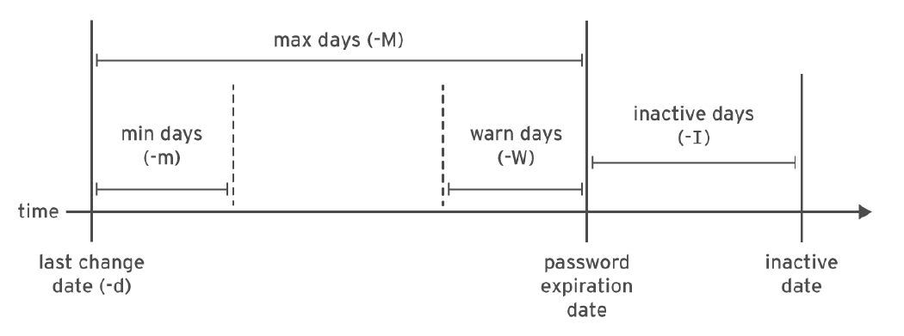
Password aging

Slide 5


displays the password aging
[root@host ~]# chage -l user03

Slide 6
chage command
[root@host ~]# chage -m 0 -M 90 -W 7 -I 14 user03

Slide 7
Force update
[root@host ~]# chage -d 0 user03

Slide 8
Expire user
[root@host ~]# chage -E 2019-08-05 user03

Slide 9
HINT!
[root@host ~]# date -d "+45 days" -u

Slide 10
Restricting access
[root@host ~]# usermod -L user03
[root@host ~]# usermod -L -e 2023-12-05 user03

Slide 11
Unlock user
[root@host ~]# usermod -U operator1

Slide 12
The nologin Shell
[root@host ~]# usermod -s /sbin/nologin user03

